Slide 1

PNEUMONIA DETECTION SYSTEM
Amaya Thayyil
Mohit
Mownetharan
Y Yashodhar
Yegireddi Vamsi

Slide 2


CONTENTS
Problem Statement
Approach
Observations
Graphs

Slide 3
Pneumonia is an infection in one or both lungs. Bacteria, viruses, and fungi cause it. The infection causes inflammation in the air sacs in your lungs, which are called alveoli. Pneumonia usually manifests as an area or areas of increased opacity on CXR. To detect pneumonia, we need to detect inflammation of the lungs. In this project we build an algorithm to detect a visual signal for pneumonia in the medical images that have been provided.
PROBLEM STATEMENT

Slide 4
APPROACH
DATA UNDERSTANDING
EDA
DATA PREPARATION
MODELLING
DEPLOYMENT

Slide 5
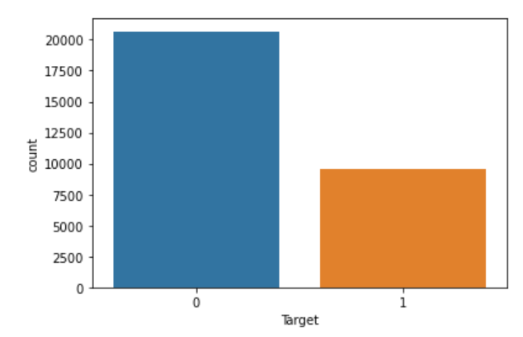
EDA
Graph showing count of infected and non-infected

Slide 6
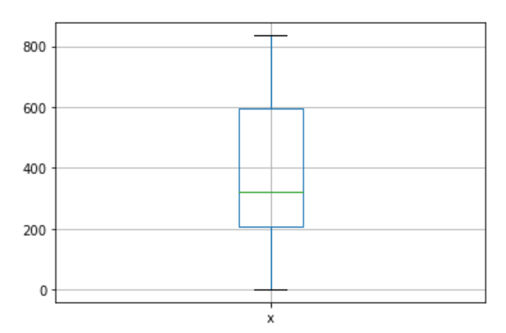
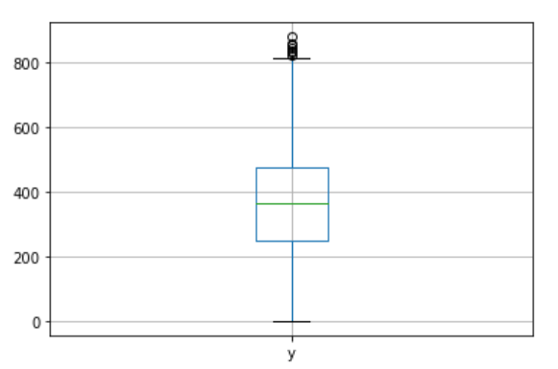
Box plot showing distribution of x and y

Slide 7
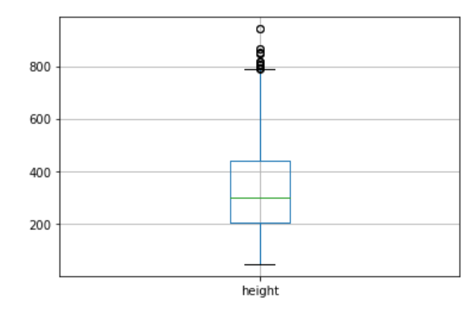
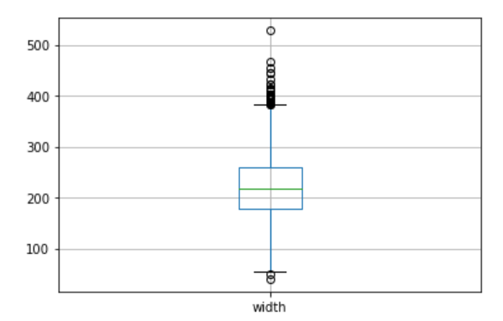
Box plot showing distribution of height and width

Slide 8
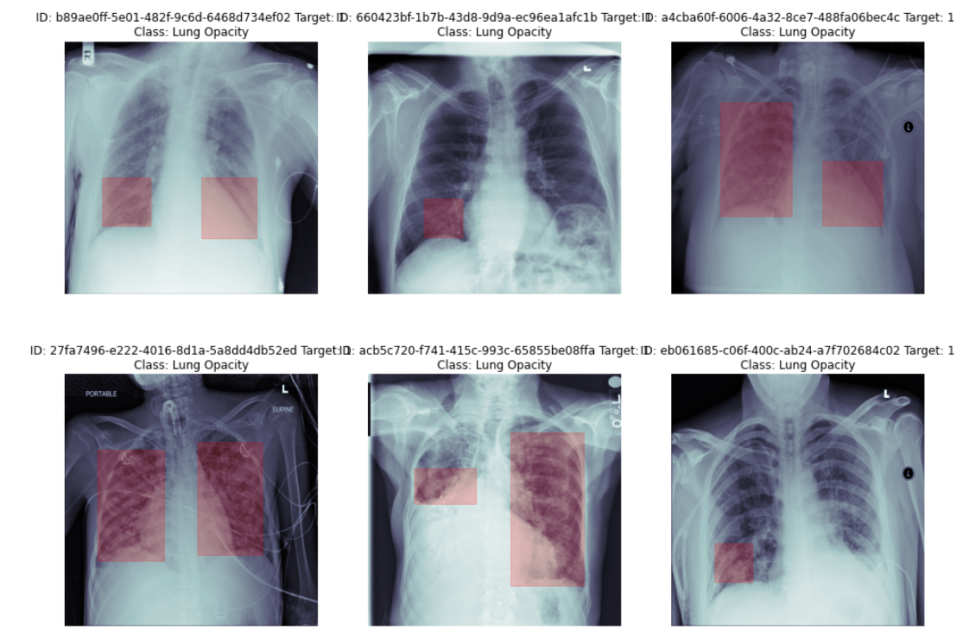
Images with bounding box

Slide 9
OBSERVATIONS FROM DATA
The train labels dataset had 20,672 null values in each of the dimensions.
The class info dataset was found to be imbalance with 66% not infected and 33% being infected
The dimensions x,y, width and height was available only for patients with pneumonia.

Slide 10
DATA PREPARATION
Four separate datasets have been given to us: two were dcm files with lung images, the third one contained patient ids and class information, and the final dataset had patient ids and dimensions of the pneumonia infection
The images that were sent to us were in dcm format; these image files were converted into pixel array format.
The image was reduced from its original size of 1024 by 1024 to 256 by 256 for the goal of speedier training.
Meta data from dcm files were extracted and the images were matched with the target variable.

Slide 11
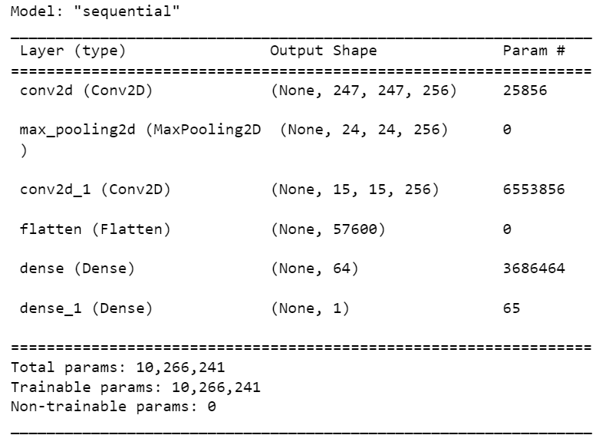
MODELLING

Slide 12
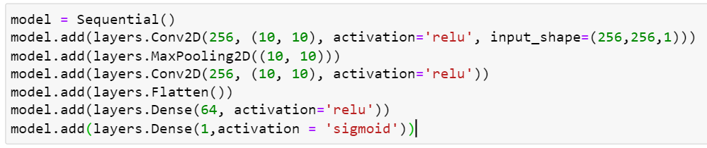
MODEL DETAILS
Number of layers - 6 - conv2d, maxpooling2d, flatten, dense
Activation functions-relu, sigmoid
Loss function-binary cross entropy
Optimizer-adam
Metrics - accuracy

Slide 13
DEPLOYMENT

